Slide 1


Communication Subsystem
By Ei Phyu Phyu

Slide 2
Outline
Function and Performance Evaluations
Product Breakdown Structure – WBS
Communication Links
Communication RAS (System and Design Requirements)
Schedule

Slide 3
S/N | Function | Perfomance Evaluations
1 | Receive uplink command from GS (Ground Station), and send the received command to OBC (On Board Computer) | UHF dipole antenna to receive 435 MHz uplink command.
 |  | Transceiver to receive and demodulate the uplink command in GMSK 4800 bps rate, and AX.25 frame format.
 |  | COMM MCU to send the command to OBC through UART.
2 | Receive the Telemetry/HK data from OBC, and transmit the Telemetry/HK data to GS. | COMM MCU to receive telemetry/HK data from OBC.
 |  | Transceiver to do GMSK modulation 4800 bps rate, and AX.25 frame format to Telemetry data.
 |  | Transceiver to process CW that contains HK data.
 |  | UHF dipole antenna to transmit Telemetry/HK data using 437 MHz downlink frequency
3 | Receive the payload data (SF packets) from OBC and transmit data to GS. | COMM MCU to receive payload data from OBC.
 |  | Transceiver to do GMSK modulation 4800 bps rate, and AX.25 frame format to payload data.
 |  | UHF dipole antenna to transmit Telemetry/HK data using 437 MHz downlink frequency.

Slide 4
WBS
COM
1.1.1.3
UHF Transceiver
1.1.1.3.1
COM MCU 1.1.1.3.2
COM FM 1.1.1.3.3
Antenna
1.1.1.3.4
Antenna deployment unit
1.1.1.3.5
UHF TX
1.1.1.3.1.1
Modulator
1.1.1.3.1.2
UHF RX
1.1.1.3.1.3
Demodulator
1.1.1.3.1.4
CW TX
1.1.1.3.1.5
TX/RX Antenna
1.1.1.3.4.1
Burner Circuit
1.1.1.3.5.1
Fishing Wire
1.1.1.3.5.2

Slide 5
Communication Links
 | Uplink (Receive Mode) | Downlink (Transmit Mode) | Beacon (CW Mode)
Frequency | 435 MHz | 437.375 MHz | 437.375 MHz
Bandwidth | 26 kHz | 26 kHz | 500 Hz
Modulation | GMSK | GMSK | CW Morse Code
Output Power | (GS) | 800mW (29.03 dBm) | 100mW (20 dBm)
Rate | 4800 bps | 4800 bps | 20 wpm

Slide 6
Communication RAS
S/N | System requirement | S/N | Design Requirements | S/N | Verification Requirements | Verification Method
SR 1.1. | Satellite shall be able to receive uplink command from ground station. | DR 1.1.1 | Antenna shall be dipole that receives uplink command at 435 MHz. | VR 1.1.1.1 | Get the S11 parameter of the antenna. | Use simulation tool (e.g. CST, HFSS). Use Vector Network Analyzer (VNA) at anechoic chamber test.
 |  |  |  | VR 1.1.1.2 | Measure received signal power at the antenna. | Use Spectrum Analyzer (SA) at anechoic chamber test. Use SA at Long Range Test (LRT).
 |  | DR 1.1.2 | Modulation shall be GMSK at 4800 bps data rate. | VR 1.1.2.1 | Confirm the output waveform at the transceiver (TRX). | Use oscilloscope to check the waveform.
 |  | DR 1.1.3 | Frame format shall be AX.25 Protocol. | VR 1.1.3.1 | Determine the packet error. | Send pre-defined data and inspect the received data for errors.
 |  | DR 1.1.4 | COM MCU shall send the command to OBC through UART. | VR 1.1.4.1 | Check UART communication between COMM MCU and OBC. | Compare COMM MCU transmit data and OBC received data.
 |  |  |  | VR 1.1.4.2 | Conduct uplink success rate test. | Count packets successfully received vs. transmitted at controlled environment and at LRT.
 |  |  |  | VR 1.1.4.3 | Conduct link budget computation. | Compute for theoretical losses and gains at every critical points. Measure the losses and gains at every critical points at controlled environment, and at LRT.

Slide 7
Communication RAS
S/N | System Requirement | S/N | Design Requirements | S/N | Verification Requirements | Verification Method
SR 1.2 | Satellite shall be able to transmit telemetry and mission data to ground station. | DR 1.2.1 | COM MCU shall receive the telemetry data from OBC through UART. |  | Check UART communication between OBC and COMM MCU. | Compare OBC transmit data and COMM MCU received data.
 |  | DR 1.2.2 | Modulation shall be GMSK at 4800 bps data rate. |  | Confirm the output waveform at the TRX. | Use oscilloscope to check the waveform.
 |  | DR 1.2.3 | Frame format shall be AX.25 Protocol. | VR 1.2.3.1 | Determine the packet error. | Send pre-defined data and inspect the received data for errors.
 |  | DR 1.2.4 | Antenna shall be dipole and receives downlink command at 437.375 MHz. | VR 1.2.4.1 | Get the S11 parameter of the antenna. | Use simulation tool (i.e. CST, HFSS). Use VNA at anechoic chamber test.
 |  |  |  | VR 1.2.4.2 | Measure transmitted signal power at the antenna. | Use SA at anechoic chamber test. Use SA at LRT.
 |  |  |  | VR 1.2.4.3 | Conduct downlink success rate test. | Count packets successfully transmitted vs. received at controlled environment and at LRT.
 |  |  |  | VR 1.2.4.4 | Conduct link budget computation. | Compute for theoretical losses and gains at every critical points. Measure the losses and gains at every critical points at controlled environment, and at LRT.

Slide 8
Communication RAS
S/N | System Requirement | ID | Design Requirements | ID | Verification Requirements | Verification Method
SR 1.3 | Satellite shall be able to send CW beacon. | DR 1.3.1 | CW shall contain housekeeping data. | VR 1.3.1.1 | Check read data. | Check read display data.
SR 1.4 | COMM shall survive space environment. | DR 1.4.1 | COMM shall be able to survive thermal test in the range of -10C to 45C. | VR 1.4.1.1 | Shall confirm the COMM can survive thermal test. | COMM operational test in laboratory.

Slide 9
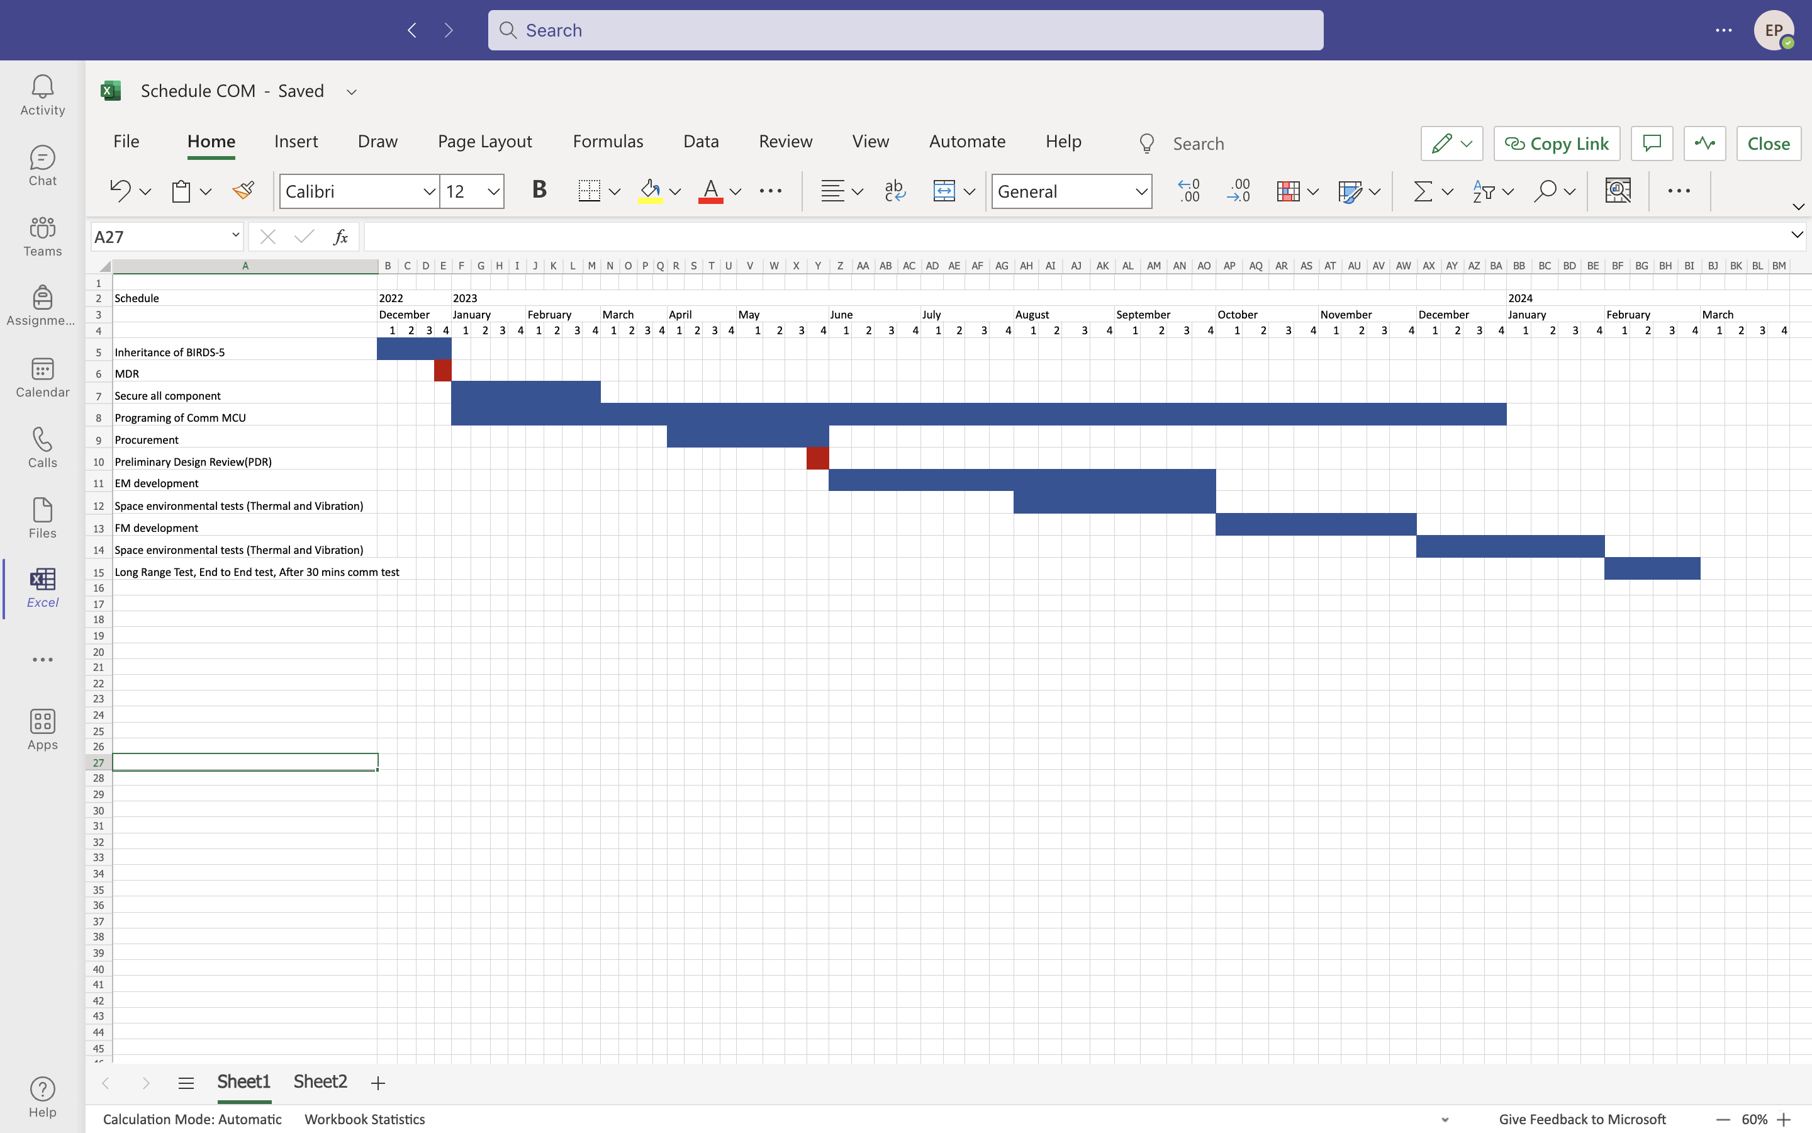
Communication Subsystem Schedule

Slide 10
Antenna Deployment
MDR

Slide 11
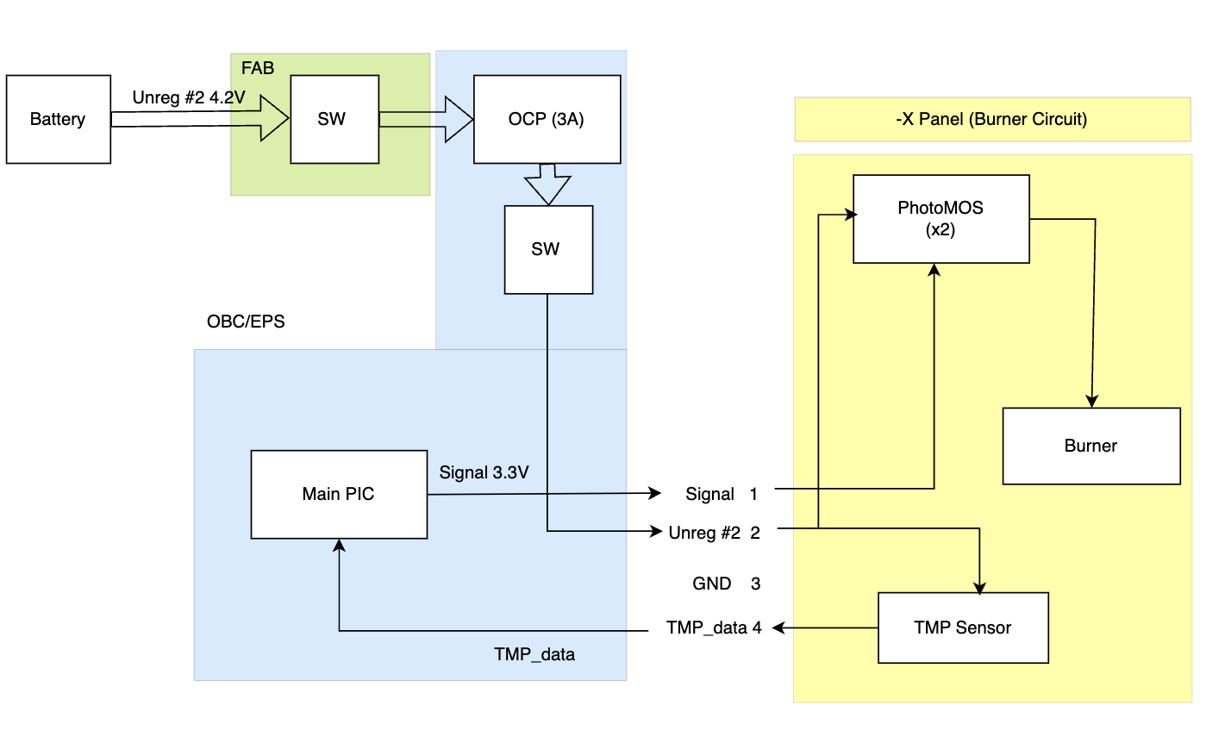
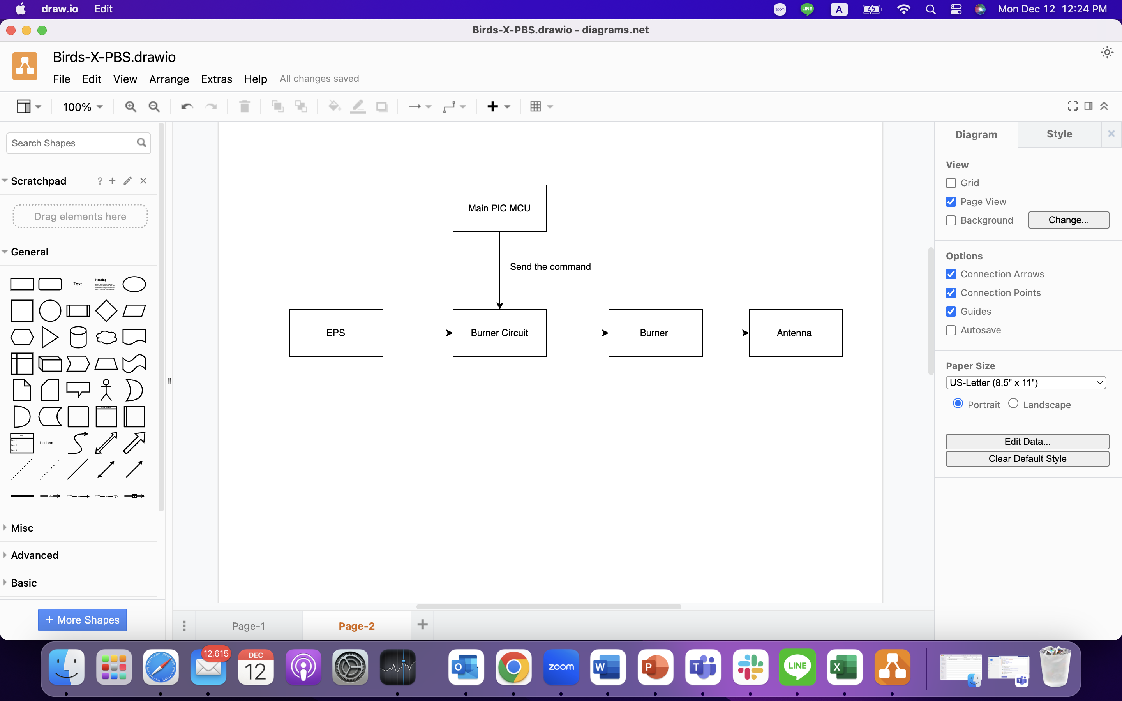
Block Diagram for Antenna Deployment
Antenna Deployment
Function - To achieve the deployment of UHF antenna successfully by using the circuit burner mechanism

Slide 12
Antenna Deployment RAS
S/N | System requirement | S/N | Design Requirements | S/N | Verification Requirements | Margin | Verification Method
SR 1.1. | The Antenna shall not be deployed before satellite release from ISS | DR 1.1.1 | Antenna shall be securely stored in the satellite | VR 1.1.1.1 | Ensure that the wire holding the antenna shall securely store the antenna |  | Fit to check wire tension
 |  | DR 1.1.2 | Antenna shall not deploy inside JSSOD pod | VR 1.1.2.1 | Antenna shall not deploy during different vibration conditions. |  | Vibration tests
 |  | DR 1.1.3 | Burner Circuit shall not activate within 30 mins after the satellite release from ISS | VR 1.1.3.1 | Measure the time when the burner circuit is activated |  | Long duration test, end to end test, after 30 mins comm test
SR1.2 | Antenna shall be deployed after satellite release from ISS | DR 1.2.1 | Burner circuit will be activated 30 mins after the satellite release from ISS | VR 1.2.1.1 | Measure the time when the burner circuit is activated | +1 min | Functional and deployment test.
 |  | DR 1.2.2 | One Antenna is completely deployed within 20 sec after the burner circuit activated and another antenna is deployed after next 10 mins. | VR 1.2.2.1 | Measure the time when the antenna is completely deployed | +/- 5 sec | Functional and deployment test.
 |  | DR 1.2.3 | EPS shall supply 3.6 to 4.2 V unregulated voltage and 3A current to Burner Circuit | VR 1.2.3.1 | Measure supply voltage and current to the Burner Circuit | 3.6-4.2 V/ 3A | Functional and deployment test.

Slide 13
Antenna Deployment RAS
ID | System requirement | ID | Design Requirements | ID | Verification Requirements | Verification Method
SR 1.3. | Antenna Deployment system shall be done with design limitations | DR 1.3.1 | Position of antenna and antenna deployment components shall not affect other subsystems operation | VR 1.3.1.1 | Make design simulation of the position of each components | CAD design inspection system functional test
 |  | DR 1.3.2 | Antenna deployment mechanism will not harm the astronaut safety | VR 1.3.1.2 | Check material | Vibration tests
SR 1.4 | Antenna shall be able to receive and transmit from and to ground stations respectively | DR 1.4.1 | Antenna shall be dipole operating at 435 MHz and 437.375 MHz UHF amateur band | VR 1..4..1.1 | Get the S11 parameter of the antenna(ensure antenna length is around 17.2 cm) | Use simulation tool (i.e CST, HFFS) Use Vector Network Analyzer (VNA) at anechoic chamber test
 |  | 1.4.2 | S and F and APRS antenna shall work at 144-146 MHz | 1.4.2.1 | Ensure antenna length is around 51.03 cm | CST Simulation Antenna measurement
 |  |  |  | VR 1.4.2.2 | Measure received signal power at the antenna | Use spectrum analyser (SA) at anechoic chamber test Use SA at Long Range Test (LRT)

Slide 14
Antenna Deployment RAS
SR 1.5 | Antenna deployment system shall be able to withstand the space environment | DR 1.5.1 | Antenna deployment system shall be able to survive thermal test in the range of -10 Deg Cel to 45 Deg Cel | VR 1.5.1.1 | Shall confirm the antenna deployment system can survive thermal test | Antenna deployment system operational test in laboratory
SR 1.6 | Antenna deployment system shall be able to perform the anechoic chamber test. | DR 1.6.1 | Antenna deployment system shall be able to perform anechoic chamber test. | VR 1.6.1.1 | Shall confirm the antenna deployment system can perform anechoic chamber test. | Antenna deployment system operational test in laboratory

Slide 15
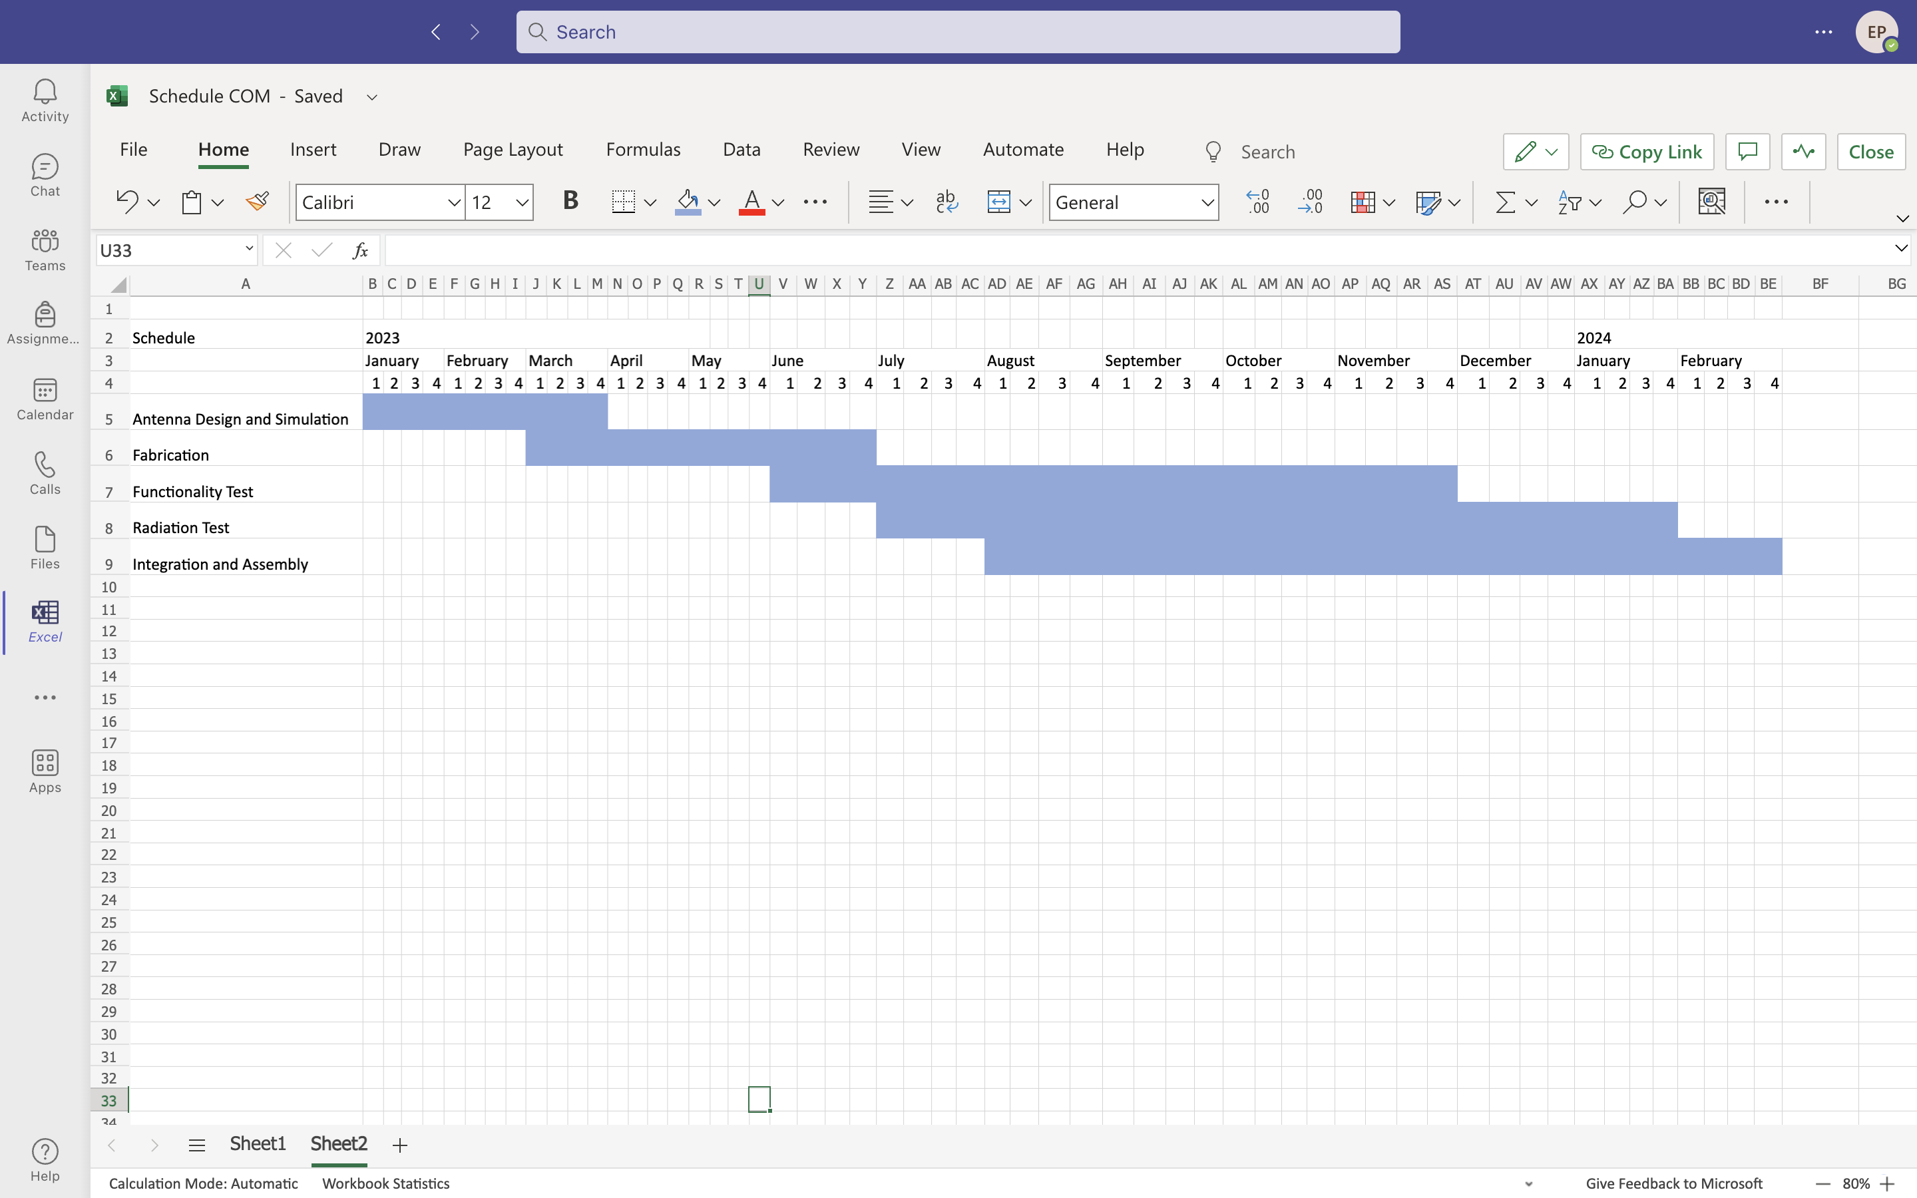
Schedule

